Slide 1
Preparing for a Room Design
Lesson 2

Slide 2
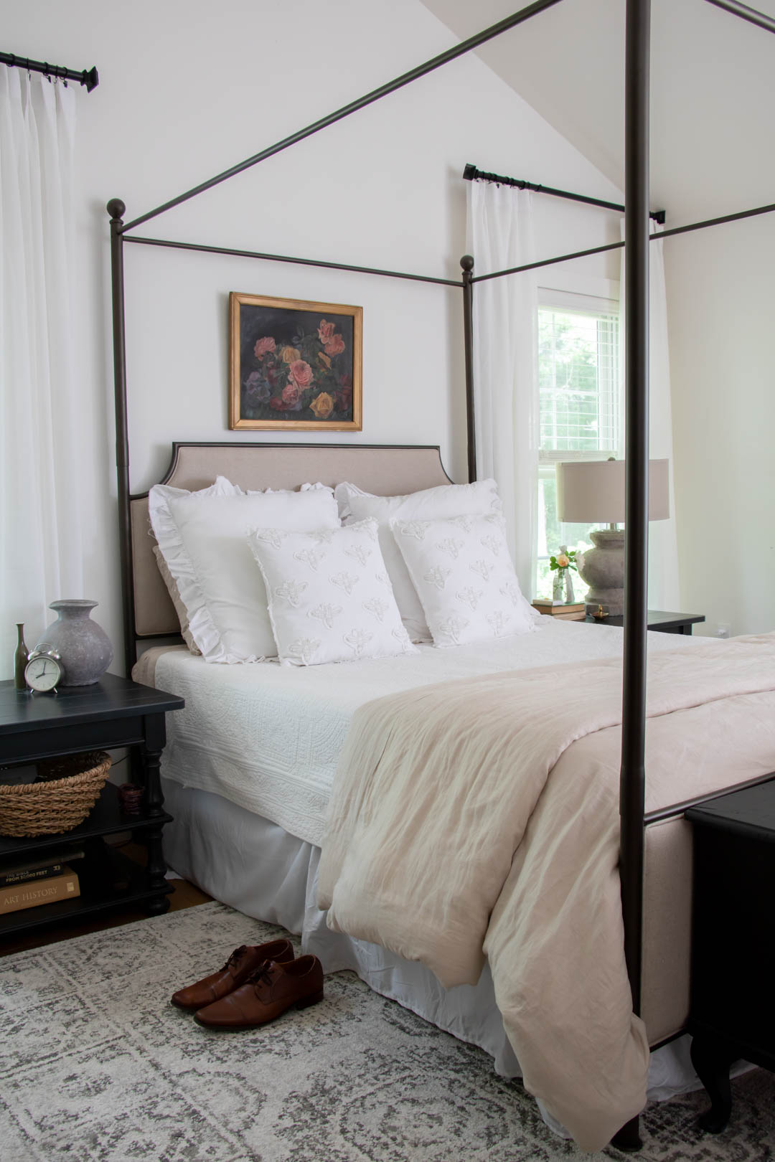
Steps to starting a Room design
Declutter/organizing
Use of Space
Layout
What items are needed to complete your space for function and design.
Deciding on Color
Creating a Design Board/Mood Boards
Budget
Accessories

Slide 3
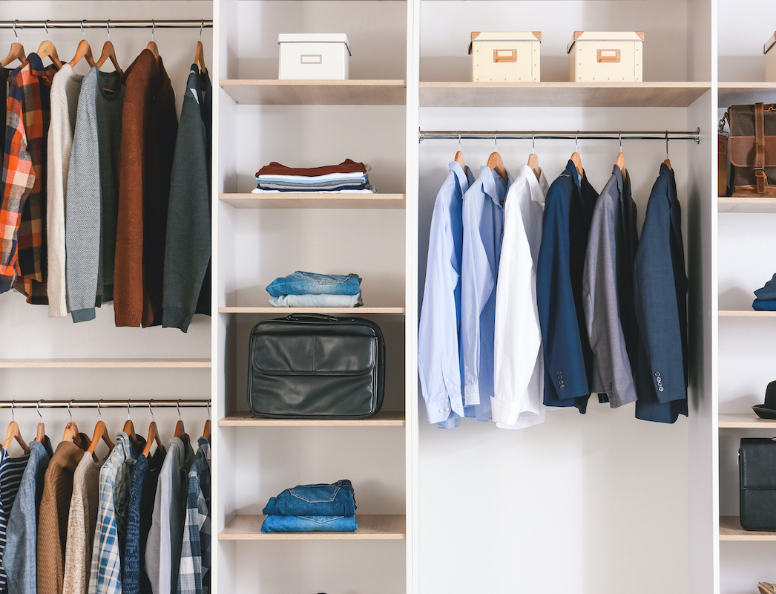
Decluttering
Sticky Note Challenge
Start with one room at a time.
Categorize the items in the room with:
Stay
Move to another room
Toss
Donate
Sell (FB Marketplace)
Repurpose

Slide 4
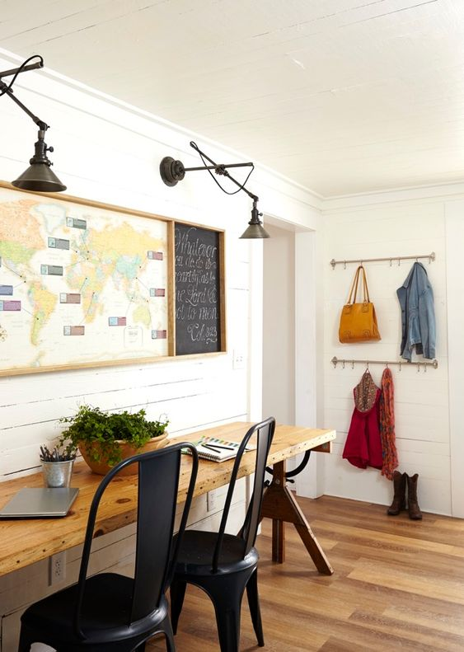
Use of the space
What is the room going to be used for?
The room’s purpose can change with your new lifestyle or family changes/ room function
A room is allowed to have more function it’s just about it all being in its own place. For example: guest room/office, playroom/gym, dining room/homeschool room.

Slide 5
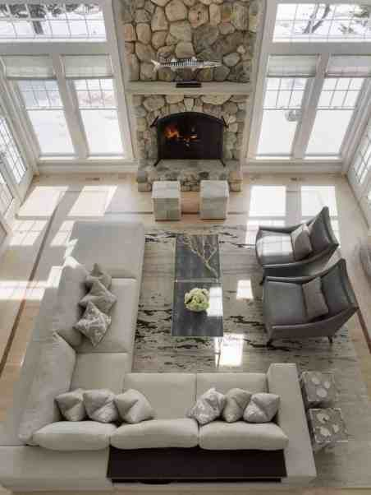
Layout
Decide on the layout of your space once you know the function. Keep in mind a few things…
Conversation
Focal point(s)
Walking space
Work for your daily needs and entertaining needs
Even if you do not know the exact pieces yet for this space envision the items that will be helpful for the room function and design.
Think about the pieces that you already have on hand and how they can fit into this layout.

Slide 6
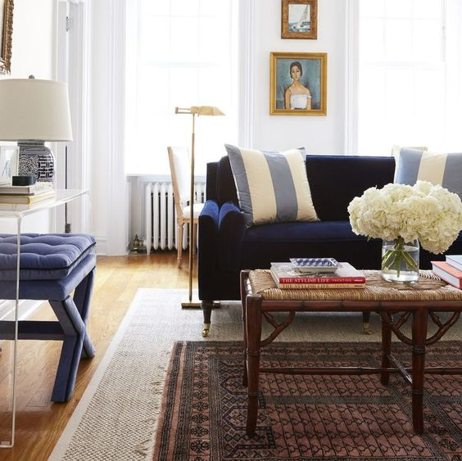
Think about these items for the space
Shape of tables
Sectional vs sofa & arms chairs
Ottomans (for extra seating, storage)
Additional tables to place a drink or book
Lighting
Artwork
Focal Point? (TV, fireplace, furniture piece)

Slide 7
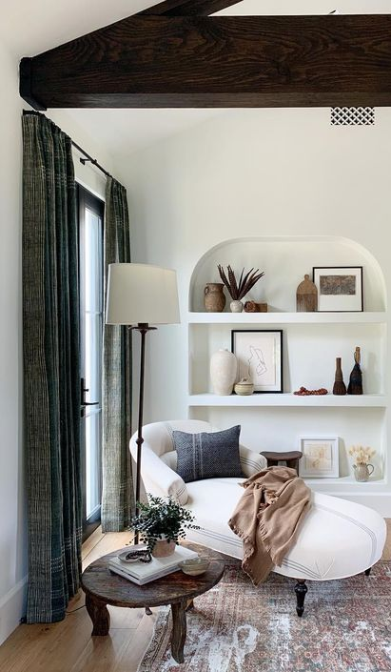
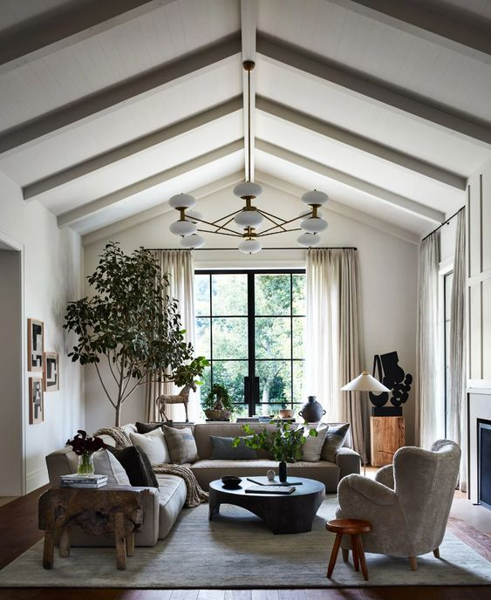
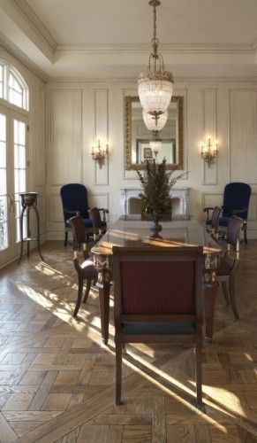
Consider the Corners of the room
Design with Function & Style
Work with a
Focal Point

Slide 8
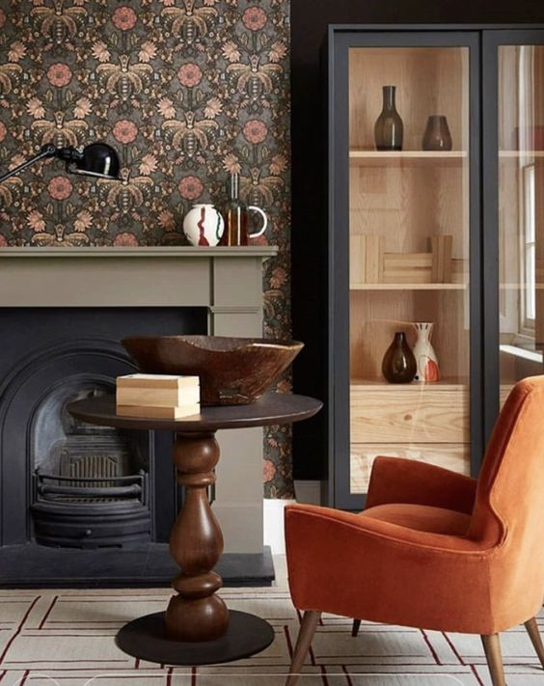
Deciding on Color-This creates a room’s personality
Inspiration for your color influence:
Wallpaper
Painting/picture
Rug
Color Scheme

Slide 9
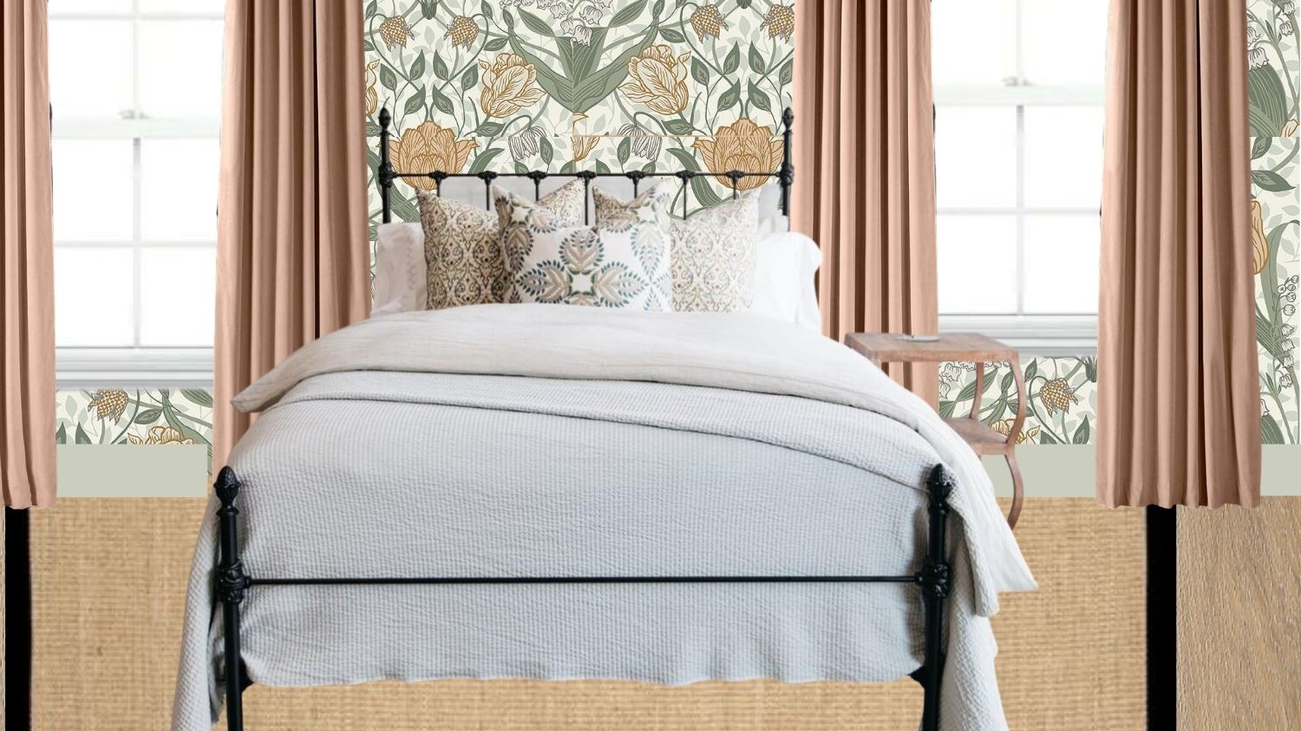
Design Board
When starting a full room or house makeover using a Design board will keep you organized
You can bring a room together and see how they look together cohesively before making a purchase or painting a wall.
Help you from swaying in the middle of a design especially if it takes time to evolve (this is not HGTV show)

Slide 10
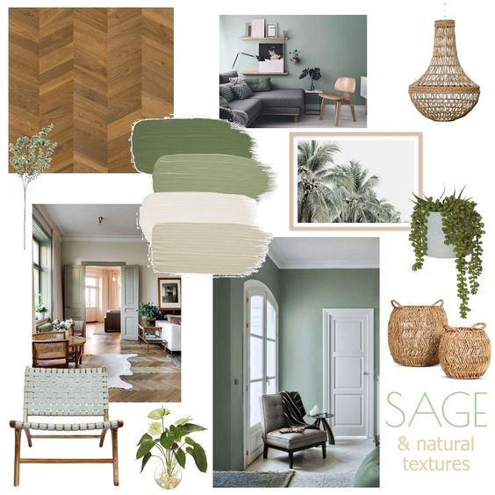
Mood boards
You can also consider a mood board for when you don’t have total vision yet for the space but want to get a feel for a room.
Grab items, colors, artwork, flowers, etc to make a mood board come to life for your vision.

Slide 11
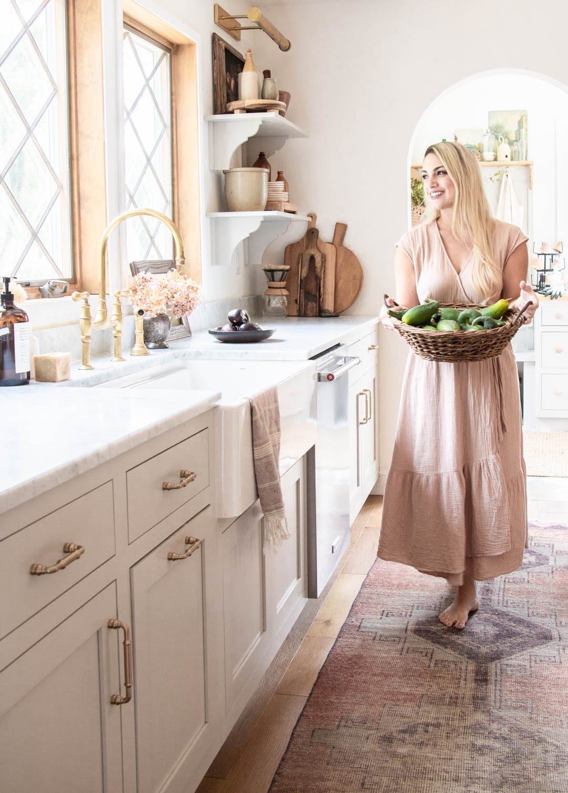
Budget
Before totally diving into a makeover you want to consider the budget for a space.
What to splurge on (larger items in the room or ones that need to stand up to ware and tear)
The quality of a room will show through on those large pieces.
What can you use that you already have (to save money)
Consider adding to a room over time which can be outside your “makeover” budget. (accessories, curtains, artwork)

Slide 12
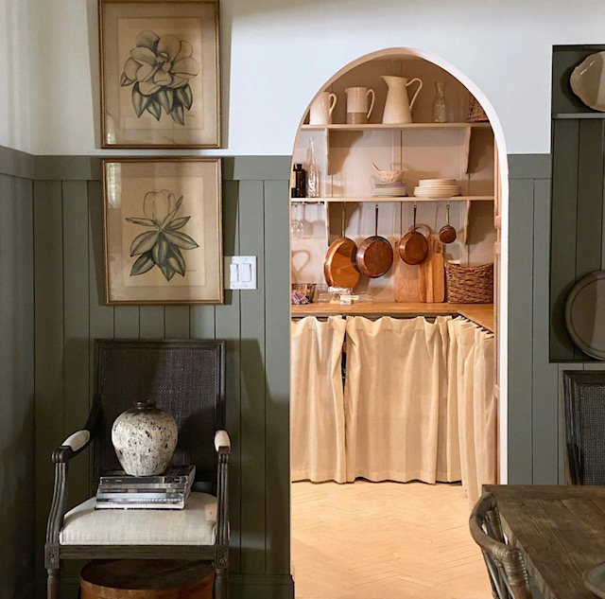
Biggest Impact
When you don’t have the budget or time to do a full makeover what should you consider?
Lighting & Paint- always makes the biggest impact!
Lighting- updated light fixture & dimmers
“Staging” with items you already have
Accessorizing to make a space feel more cohesive. (compliment or hide)

Slide 13
A few things to consider…
Function of a space
What are the quirks of the room and how to embrace them (ex. Odd nooks, tiles you cannot change, the shape of the room, etc.)
How the room works with the rooms around it- transitioning well!
Does the Pinterest photo work for my home and lifestyle?
What items to choose for function and what items for beauty? YOU CAN HAVE BOTH!
Do not settle, design a room you love! (unless timing is not right)
Make items in the room you don’t love Work! Ex. Tablecloth hide an ugly table, large curtains around a tiny window, if it is a rental work with the color on the walls and not against them, update even the smallest details.
Consider the view from the chair in the room (are the pictures hung too high, does it function well for lounging, what are the focal points)
Budget- where to splurge and where not to

Slide 14
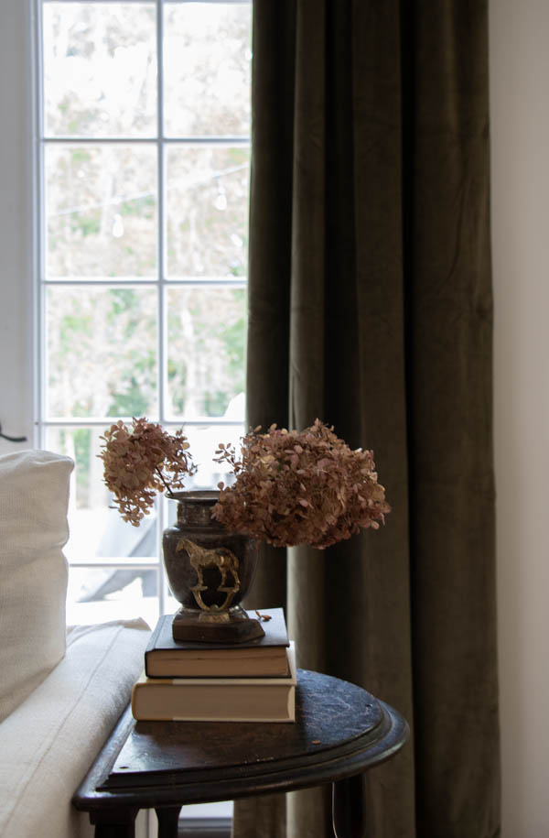
Recap
First you must decide what can stay and what HAS TO GO!
What is the use of the room for your lifestyle?
Consider the layout before anything else
Decide on Color for the space inspired by an item or color scheme
Rely on a Design or Mood board
Design a room that works in your current space not the Pinterest image. Recognize the quirks and work with the items you can not change even if that requires hiding, disguising, repurposing.
DO NOT SETTLE!
Always have a budget
All else fails update the paint and lighting!

