Slide 1
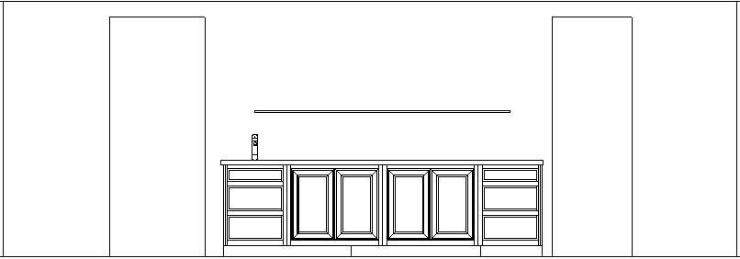
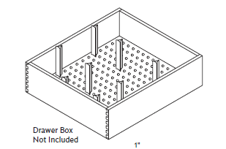
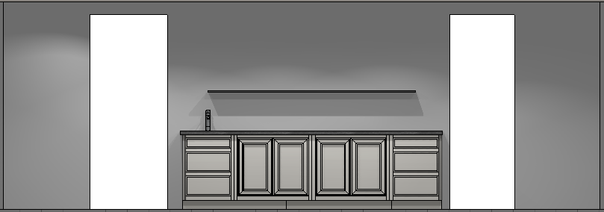
Kitchen Perimeter Cabinets – Harvey flat front, Inset Beaded Maple Custom Color French Canvas (BM)
*hold off right now
3 Drawer Base w/ undermount sink
Top drawer is a sink font – tilt out
Middle drawer is prepped for plumbing
MCIPEL – inset panel left, SFT10I – sink front installed top, MCP – middle drawer prepped for plumbing, MCMCL – miter corner left, MCWBR – wide bottom rail
Sink Specs – 12x 12 x 6
3 Drawer Base
Double tiered cutlery divider drawer – DTCDB24
Same size as sink base for symmetry
MCIPER – inset end panel, MCMCR – miter corner
(Dinner plate storage) Drawer divider post set in middle drawer
Base 36 with Roll Trays
Two of them side by side
Has two roll trays installed in both cabinet
Full height cabinet to house small appliances, etc.
Will show finial hinges (brass,
Cabinets will be combined to eliminate the middle seam between the cabinets
MCWBR – wide bottom rail mod
Use the 12’ base shoe moulding so there are no seams

Slide 2
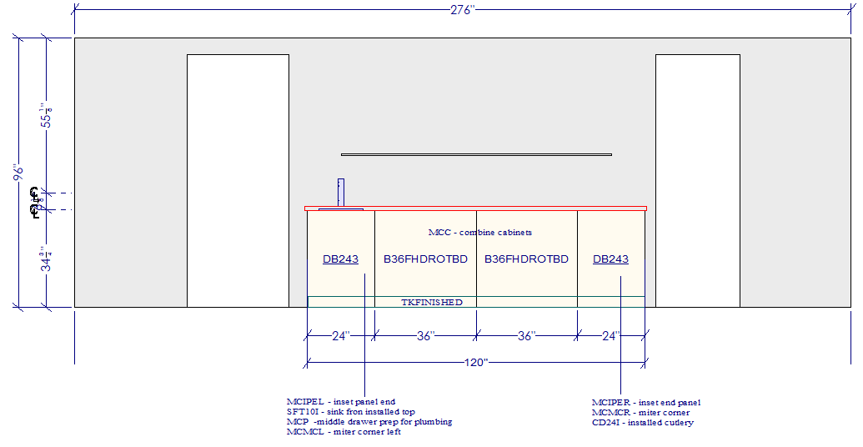
Kitchen Perimeter Cabinets – Elevation
Right now this is a floating shelf
MCWBR – wide bottom rail mod
FB12 – 12’ base shoe
MCWBR – wide bottom rail mod
DTCDB24
DDPS – drawer divider
(2) APS - posts
MCWBR – wide bottom rail mod

Slide 3
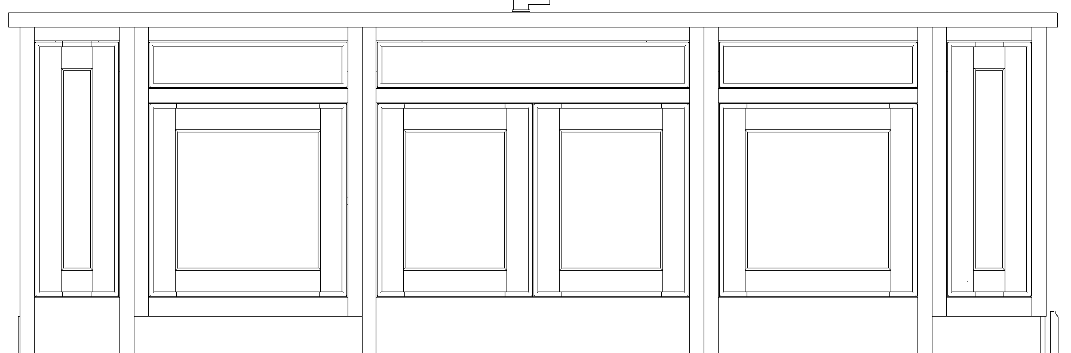
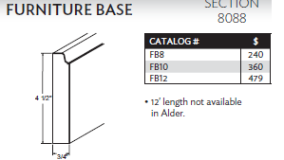
Kitchen Island Front– Harvey flat front, Inset Beaded Maple Custom Color French Canvas (BM)
BPO3UB12
Utensil pullout
Side is prepped for custom end panel
Base Wastebasket
Includes a drawer on top and a double bin wastebasket in the bottom pullout- SD24 spice drawer in top drawer
No finial hinges
Base Tray Divider
Base Tray Divider Cabinet
The side will be prepped for the wainscot custom panel showing 3 drawers
Will show finial hinge
Sink Base
36” in width to house an undermount sink
Door racks and cabmat included
Can show final hinges
Sink : 32 x 30 x 8.5
Tilt down
Dishwasher
This paneled DW can match the look of the wastebasket located to the right of the sink
No finial hinges
Use the 10’ base shoe moulding so there are no seams
Base board moulding used on sides and back

Slide 4
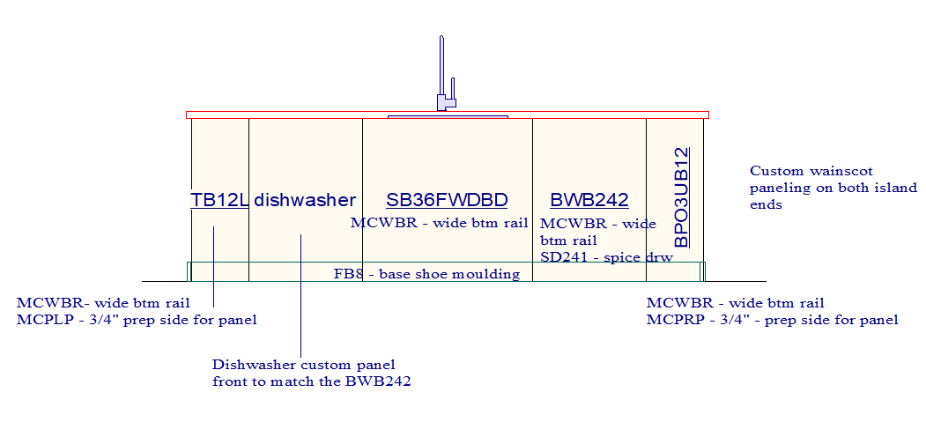
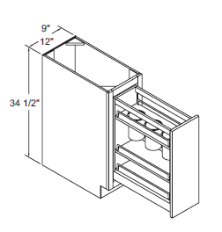
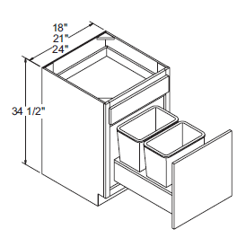
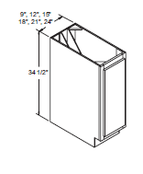
Kitchen Island Front– elevation
pullout- SD24
Base board moulding used around entire island

Slide 5
Kitchen Island Back– Harvey flat front, Inset Beaded Maple Custom Color French Canvas (BM)
B36FWDBD –
MCWBR – wide bottom rail
DLDR – no cabinet doors
MCMI – matching interior
MCRD – reduce depth 12”
MCPLP – ¾” prep cab for end panel
(3) Separate open bookcases
12” deep cabinets with small drawer at the top
Use the 10’ base shoe moulding so there are no seams
Base board moulding used on all sides of island

Slide 6
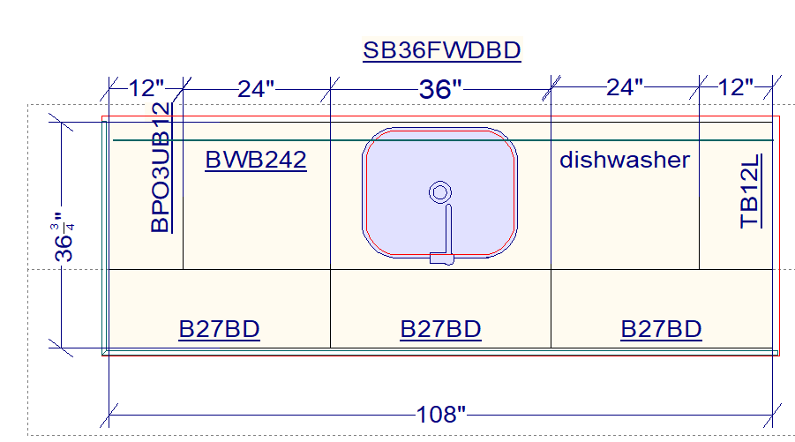
Kitchen Island Floor Plan– Harvey flat front, Inset Beaded Maple Custom Color French Canvas (BM)
Sink base
Island Details
The island has a tray divider, sink base, wastebasket, container storage
Open storage on the back with top drawers
Add two dividers for a junk drawer
Base
Waste Basket
Base Container
Pullout
Tray
divider
Open bookcase cabinets
B36FWDBD
B36FWDBD
B36FWDBD
Island Side Detail – “custom wainscot panel”
The side of the island will show three drawer fronts that equal the same spacing as the back cabinetry ( Standard three drawer base)
Base shoe moulding to wrap the entire island
Use flat panel on sides
(2) B36WD Interior Details
Place 4 dividers evenly spaced in two of the B36BD top drawers
36” in length, RD to 12”
(4) TDD

Slide 7
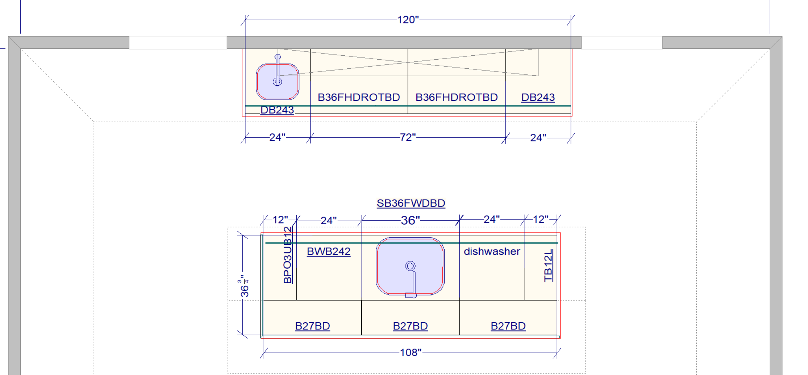
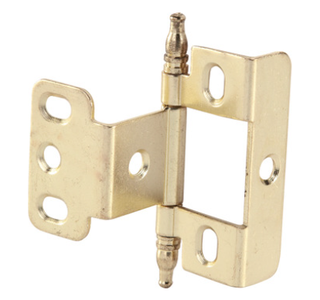
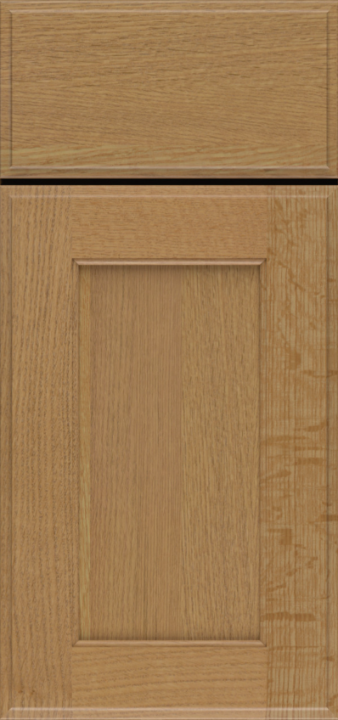
Floor plan
B36FWDBD
B36FWDBD
B36FWDBD

